Slide 1

AICommunityMobile
Empowering Kentucky’s Immigrant Workforce
Essential Innovations LLC
LOGO HERE

Slide 2

AICommunityMobile
A multilingual AI assistant designed for Kentucky’s immigrant and refugee communities.
Provides real-time translation and job information in multiple languages.

Slide 3


Workforce Barrier for Immigrants & Refugees
Over 300,000 immigrants & refugees in Kentucky face difficulties entering the workforce.
Language barriers and complex bureaucratic systems create friction in employment access.
Current solutions are manual, slow, and fragmented—leading to underemployment and economic disparity.

Slide 4

Key Features
✅ Adzuna API call for posted jobs
✅ Gemini API for language detection and translation
✅ Real-Time Translation for user interactions
✅ Translated job queries in selected language
✅ Fast and reliable job search

Slide 5
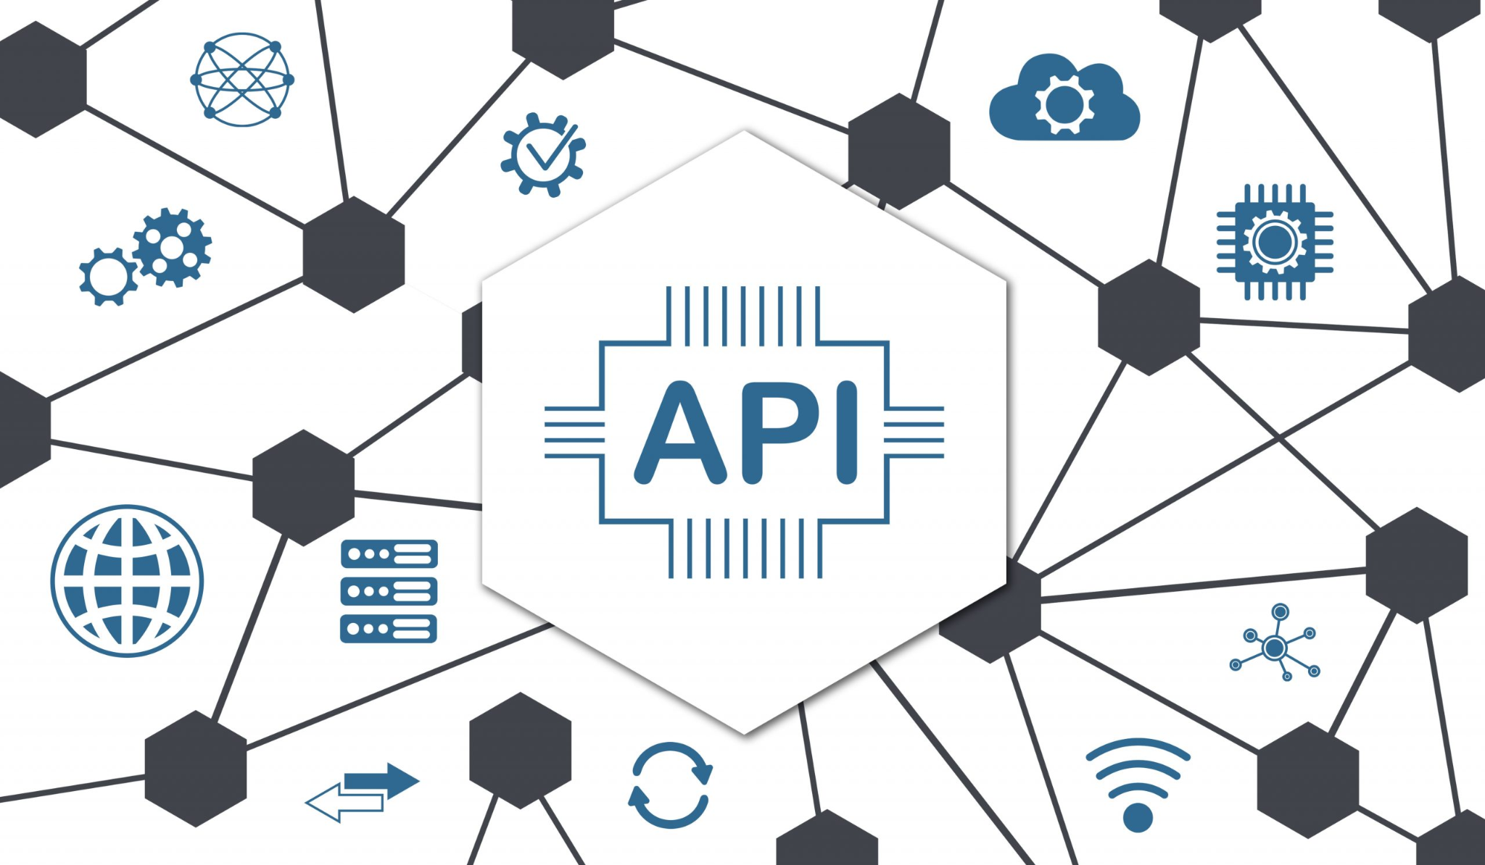
How It Works
User Queries in English/Native Language → Gemini translates if required & returns the closest related term.
API Fetches & Simplifies Workforce Info → Uses Adzuna API & structured data sources in Python.
Frontend displays the data package
→ Websocket connection passes the data & the website displays it

Slide 6

Technical Stack
Frontend: React (HTML/ CSS/ JSX)
Backend: Python
Connection: Websocket
AI & NLP: OpenAI GPT-4, Google Gemini
APIs: Gemini API, Adzuna Api

Slide 7

Who We Serve
Primary Users: Immigrants & refugees seeking employment in Kentucky
Beneficiaries:
Employers & workforce development organizations
Nonprofits & advocacy groups
Government agencies
Impact:
✔ Faster job placement
✔ Improved access to critical resources
✔ Economic upliftment & integration

